Slide 1

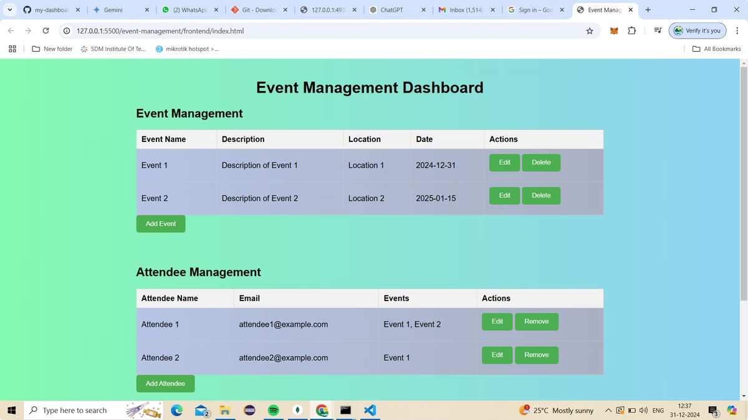

Event Management Dashboard: Streamlining Your Events
Welcome to the Event Management Dashboard presentation. We'll explore key features and benefits of this robust platform, designed to simplify and enhance your event management process.
by PRUTHVIRAJ P KARJAGI

Slide 2
Built with Modern Technologies
HTML
CSS
JavaScript
Provides the structural foundation for the dashboard's user interface.
Ensures a visually appealing and responsive layout, adapting to different screen sizes.
Enables interactive elements and dynamic functionality, enhancing user experience.

Slide 3

Intuitive Interface
Name
Email
Registration Date
John Doe
john.doe@email.com
2023-12-01
Jane Smith
jane.smith@email.com
2023-12-05

Slide 4



Secure Data Operations
GET
POST
Retrieves participant data, powering insightful reports and analysis.
Allows secure data submission, ensuring accurate registration and updates.

Slide 5

Scalable Data Storage
MongoDB
1
Provides a flexible and scalable NoSQL database for efficient participant data management.

Slide 6

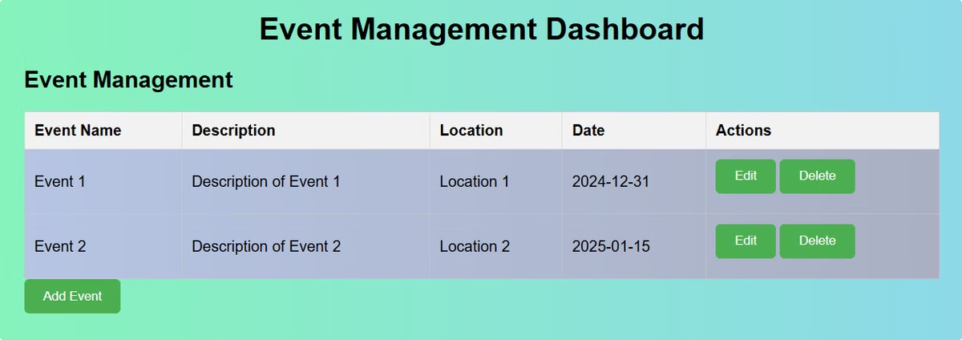
Effortless Participant Management
1
Edit
2
Add
Modify participant details with ease, ensuring accurate information.
Streamline registration with a user-friendly interface for adding new participants.
3
Delete
Remove participants from the system efficiently, maintaining accurate records.

Slide 7

Real-time Insights and Control
100%
24/7
Data Integrity
Accessibility
Guaranteed through robust validation and error handling.
Access key information anytime, from any device.

Slide 8

Key Takeaways
This event management dashboard empowers you with a centralized platform for efficient participant management, secure data operations, and real-time insights. It offers a user-friendly interface, robust features, and scalability for seamless event planning and execution.

